Slide 1

Skills scout
By Ambhoj Adhikari and Mukesh Nepali Pariyar

Slide 2
Introduction
In a world where expertise makes all the difference,” Skill scout” emerges as your premier platform for connecting with skilled professionals across a variety of essential services. The Skills Scout is a website which will allows the user to find a worker for temporary work.

Slide 3
Problem Statement
Difficulty in finding reliable professionals for essential services like plumbing, electrical work, driving, and mechanics.
Frustration due to inconsistent availability and responsiveness of service providers.
To contact workers a long process is done.

Slide 4
Objectives
To provide platform for short-time worker.
To recommend the worker available in the area.
Provide employment related services.

Slide 5
Requirement Identification
For this project, we researched and reviewed some of the related websites and applications. Throughout the research, we get to find out that there are very few websites or applications related to on daily basis job. For the other website the workers need to give an interview for the job.

Slide 6
Functional Requirement
User
User can view the detail of worker after register and login.
User can find worker and they can contact them.
User can logout from the system
Worker
Worker can register and login the system.
Worker can upload their details.
Worker can logout from the system.
Admin
Admin can login the system.
Admin can view the registered accounts.
Admin can delete the users and workers account.
Admin can logout from the system.

Slide 7
Feasibility Study
Technical Feasibility
Economic feasibility
Operational feasibility

Slide 8
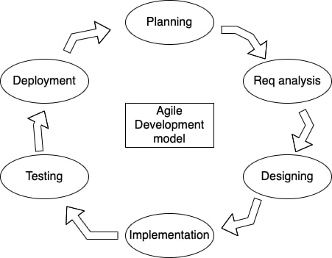
Methodology

Slide 9
Flow chart
There are two flow chart diagrams for our system.

Slide 10
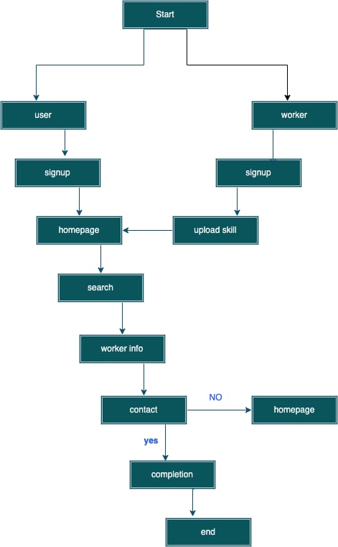
User and Worker flow chart diagram

Slide 11
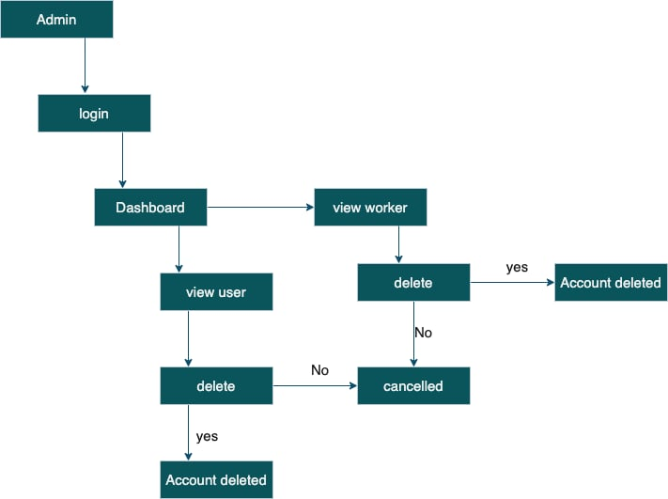
Admin flow chart

Slide 12
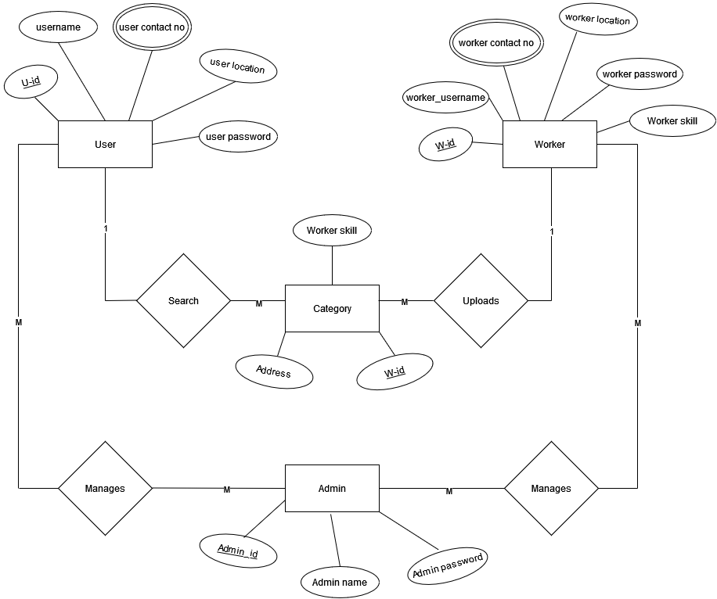
ER Diagram

Slide 13
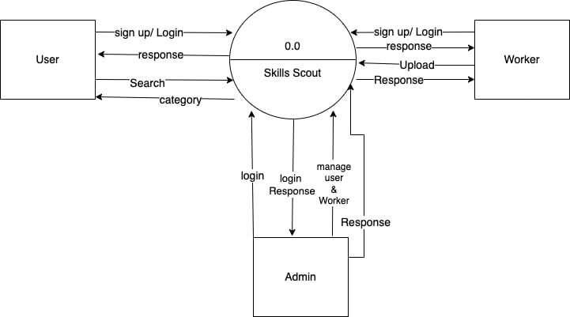
Data flow Diagram

Slide 14
Expected Outcome
After the completion of the system, it provides a user friendly interface where the user and worker can interact with each other. When the project is completed the user and worker will be able to register and login into the system. User will be able to search the profession or skilled that has been uploaded by worker. And they will be in contact with each other so that the system function is completed.

Slide 15
Thank you

